Slide 1

BE EXTRAORDINARY

Slide 2

Version Control
Ade Fewings, Aaron Owen, Oliver Barbaresi
Bangor University
Updated: 18/08/2022

Slide 3



eResearch
Supercomputing Wales
Available to researchers at Bangor
Research Software Engineers
Collate expert knowledge into an open and shared centralised repository
Yammer
GitHub Workshops
Projects
Acknowledgements

Slide 4





Training Workshops
Introduction to the Linux Shell
Version Control using Git
Programming Principles and Practice using Python
Advanced Python
Parallel Processing in Python
Machine learning with Python
Introduction to MATLAB
Introduction to R
See and discuss on the Yammer group and suggestions for new training courses welcome!

Slide 5
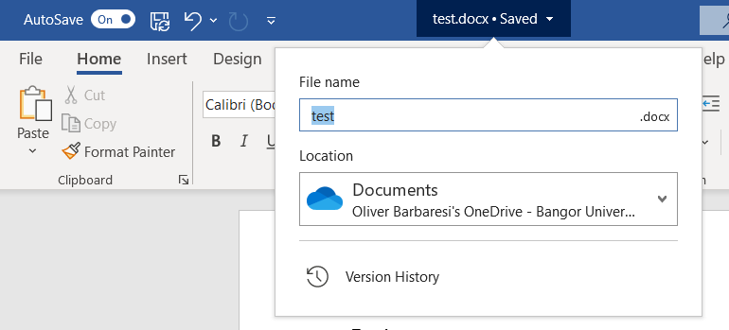
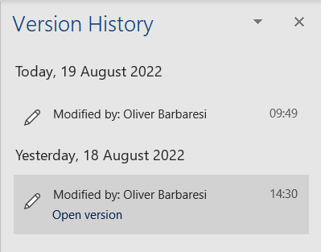
Theory: What is Version Control (VC)?
You have almost certainly used version control before, perhaps without even realising it
It’s built-in to many popular modern programs including Microsoft office and many programming environments to help keep new work saved and backed up
For example in word and other Microsoft office apps it can be accessed on the top bar:
The built-in version control is also useful in accessing unsaved documents

Slide 6
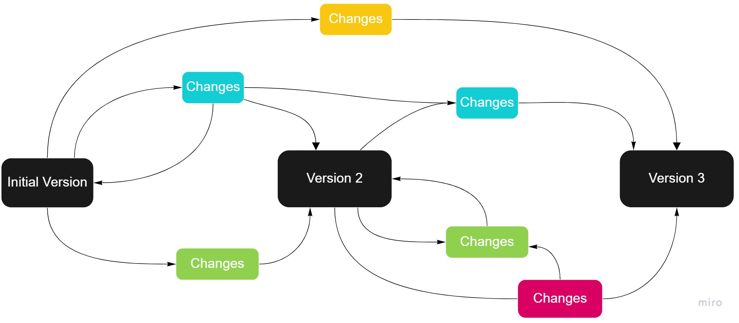
Theory: What is Version Control (VC) ?
Without VC, when working individually on different drafts, or team members working together on separate versions of a project, a mess of versions can quickly develop:

Slide 7
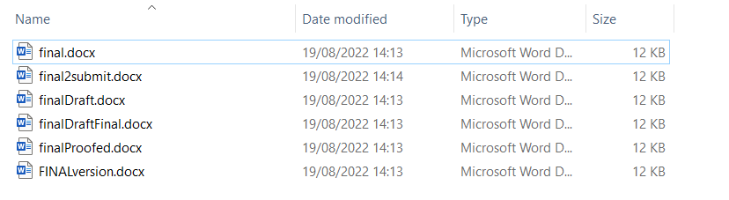
Theory: What is Version Control (VC) ?
Have you ever been writing up a document or report and when close to finishing having a folder looking like this:
And maybe working as a team the list of documents shared between everyone simply gets longer and longer

Slide 8
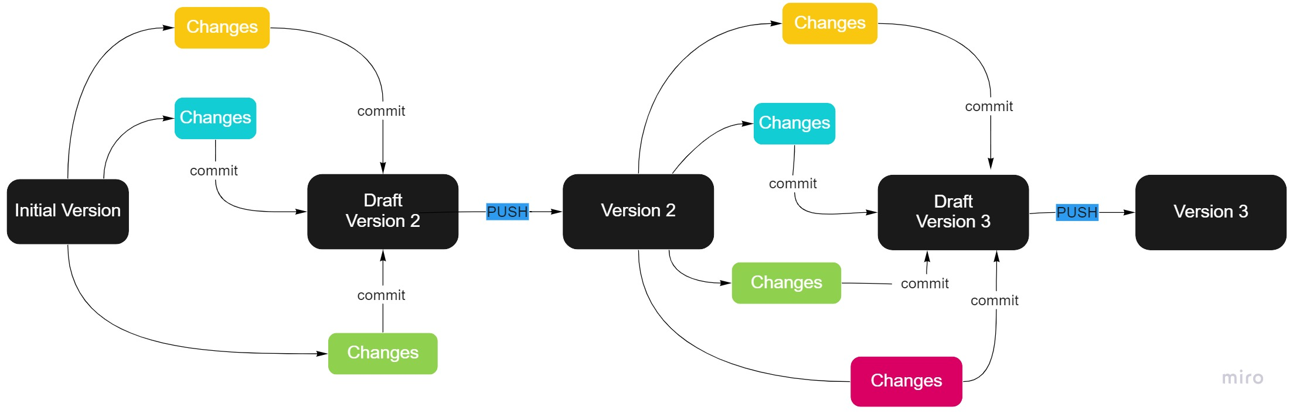
Theory: What is Version Control (VC) ?
Using VC, development is much more structured and organized from start to finish:
Don’t worry about the terms, we’ll explain these later!!

Slide 9
Theory: What are Version Control Systems (VCS) ?
A program or set of programs that tracks changes to a collection of files
Can recall specific versions of files
No need for file-new, file-new-new, file-old, file-latest, file-working
Not restricted to software development
Often used to write books, papers and online tutorials
Can be local, centralised and decentralised
Enables several team members to work on a project, even on the same file at the same time without affecting each other's work
Users are notified when there is a possibility that changes may conflict

Slide 10
Theory: What are Version Control Systems (VCS) ?
Users can revert to a previous version - Unlimited undo
See all the changes made to a project, when the changes were made and who made them
Include messages on each save (commit) to explain a reason behind it
Create branches, where changes to code can be tested without affecting the main branch
Can merge branches back into the main branch
Many different version control systems:
CVS, SVN, Git, Mercurial
This course will be using the Git VS system

Slide 11

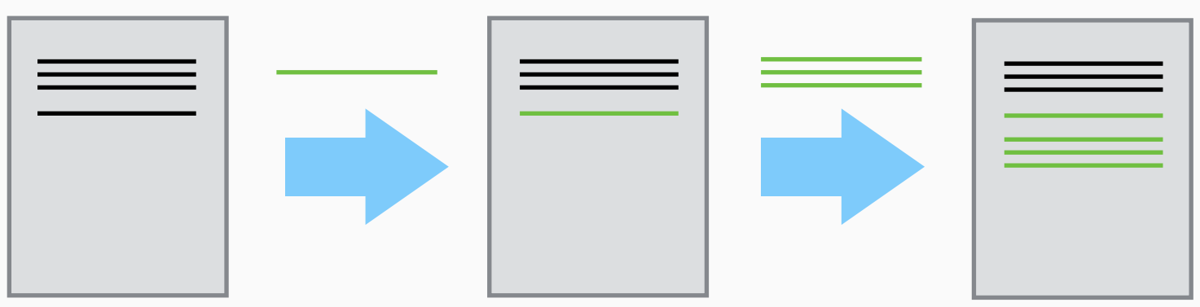
Theory: What are Version Control Systems (VCS) ?
Initialise the VCS within a directory
Create or copy a base version of a file
VCS will record changes you make each step of the way
Are able to save snapshots and include a message
Can rewind to the base file and playback each change

Slide 12
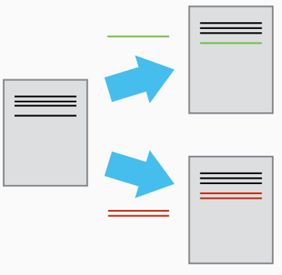
Theory: Version Control Systems (VCS)
Think of the changes as separate from the file itself
Different sets of changes can result in different versions of the file
Two users can make independent sets of changes on the same file

Slide 13
Theory: Version Control Systems (VCS)
If users make changes to different parts of a file
You can incorporate two sets of changes into the same base file
If users make changes to the same part of a file
This will result in a conflict warning and needs to be reviewed and resolved

Slide 14

What is a Git Repo or Repository?
“A repo is a data structure that stores metadata for a set of files or directory structure”
A Git repo can be thought of as the local repository to your computers C drive
Scripts and files can be uploaded, or committed to this repository along with a message
The repo is were the specific draft or version can be dropped off with a message associated with it
The repository in a simple example is like depositing coins in a piggy bank

Slide 15
Staging Area and Repository
Think of Git as taking snapshots or changes over the life of a project
In the previous analogy, the repository is the piggy bank, the staging area is your hands where the coins spend some time before being deposited (or committed) into the repository
Files can be stored in:
A project's working directory (user sees)
The staging area (where the next commit is being built-up)
The local repository (where the commits are permanently recorded)
ADD specifies what will go in a snapshot (staging area)
COMMIT takes the snapshot and makes a permanent record of it, multiple files typically being changed in one commit to represent a single functional change to the overall application. Useful commit messages are a good idea for future tracking.

Slide 16
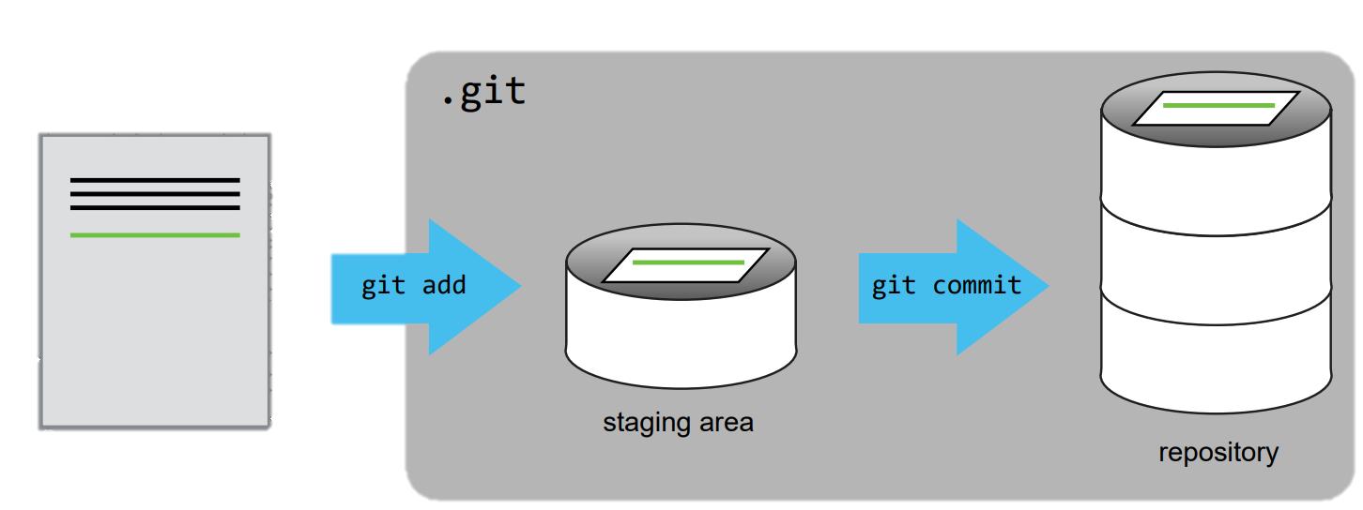

Staging Area and Repository
We’ll come to this in a bit!
PUSH takes the permanent record and stores it in the main repository (typically on GitHub)
PULL updates our local working copy (clone) with changes from the repository

Slide 17

Branches
A branch represents an independent line of development
Think of them as way to request a brand new working directory, staging area and project history
This could be a different line of development for each member in a team or a new aspect of an individual project
Allows users to develop and test new things before merging back
git branch - List all branches in our repository
git checkout –b <branchName> - Create a new branch
git push origin <branchName> - Push updates
git checkout <branchName> - Switch branch
We’ll cover these commands again later!

Slide 18
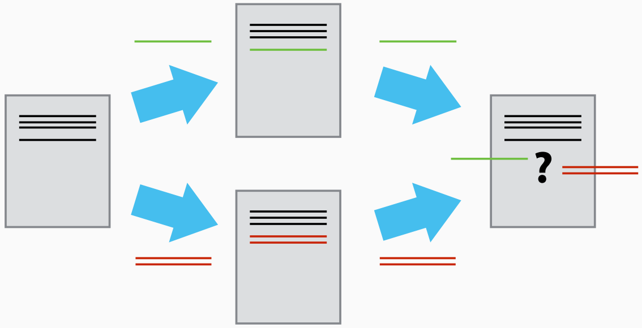
Theory: Conflicts
As soon as people can work on a document in parallel, conflicts will happen
Version Control helps us to manage conflicts by providing tools to resolve overlapping changes

Slide 19
Theory: Conflicts
Conflicts exist when changes to a file in different working copies occur concurrently and thus clash with the repository during commit/push
For example:
All users clone Aaron's repository on GitHub
Aaron updates test.txt
All users edit and move to commit and push test.txt
Users can commit the change locally but Git won't let them push it to GitHub
Why?

Slide 20
Theory: Conflicts
Practical
Git rejects the push because it detects that the remote repository has new updates that have not been incorporated into the local clone working copy
What we have to do is pull the changes from GitHub, merge them into the copy we’re currently working in, and then push that to GitHub

Slide 21
Git and GitHub
GIT
Git is a command-line tool but Git also integrates with a wide variety of graphical development environments.
Free and open-source version control system, originally developed by Linus Torvalds in 2005.
We include command line, RStudio and Visual Studio Code practical elements in this course. Please refer to whichever you need.
GitHub
GitHub is a Git repository hosting service, but it adds many of its own features.
Web-based graphical interface.
Access control and several collaboration features, such as wikis and basic task management tools for every project.
GIT is a local repository to your machine, GitHub is a cloud based repository

Slide 22
GitHub and Collaboration
The power of version control systems comes into its own when we start to collaborate with other people
It enables different people to develop different parts of a project, some elements experimentally, and eases the merging of these changes
Version control allows a particular project state at a point in time to be stored forever. Typically this would denote major changes, such as a new version
As changes are required to be attributed to a user, accountability is also introduced. This, with helpful user interfaces and meaningful messages about change enable a far more collaborative working environment

Slide 23
GitHub and Collaboration
To configure a GitHub hosted repository for collaboration among users, some simple settings are applied in the GitHub interface:
Settings
Manage access
Add people
The collaborator must accept access
The collaborator must clone the repository
Create a file with a unique name
Add, commit, push to the repo
Should see changes in GitHub from multiple users

Slide 24
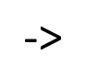
Create a GitHub Account
Set up account:
Visit https://GitHub.com/
Sign up
Verify account with University email
Create a Personal Access Token
Personal access tokens (github.com)
From your GitHub account:
Settings -> Developer settings -> Personal access token -> Generate new token
Copy the token <- Click Generate token <- Fill in the form

Slide 25
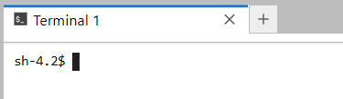
Access a Terminal
Visit https://jupyter.bangor.ac.uk/jupyter
Login using you Bangor University credentials
Select the Terminal application
Type ssh compute and hit enter
Can you see the last login credentials?
Last login: Mon Aug 15 10:10:43 2022 from …………
$ Presented with a prompt, indicating that the shell is ready to accept input:

Slide 26
A Basic Collaborative Workflow
git pull origin main - Update your local repository
git add - Make your changes and stage them
git commit -m - Commit your changes
git push origin main - Upload the changes to GitHub

Slide 27

Command Line: Configure Git
You will not be able to execute and run Git on the Windows/macOS command line without setting it up first:
Install Git Bash:
https://git-scm.com/downloads
Open Git Bash and run the following:
Set your username git config --global user.name "issa16"
Set your email address: git config --global user.email "issa16@bangor.ac.uk"
Set the default branch for projects: git config --global init.defaultBranch main
Username will be linked to your Git activity. --global For every Git project, use these settings

Slide 28
Theory: Line Endings
Different Operating Systems (OS) using different characters to represent to the end of a line in a file
Git uses these characters to compare files, it may cause unexpected issues when editing a file on different machines
dos2unix - Converts plain text files in DOS format to UNIX format
To run Git commands on your command line (or prompt) run the following Git Bash commands based on your OS:
For Linux and macOS
git config --global core.autocrlf input
For Windows
git config --global core.autocrlf true
Now try running the command git on the command line and see if it is recognised

Slide 29
Command Line: Check git config
git config -list - You can change your configuration as many times as you want

Slide 30
Git config help
git config -help
Press q to exit, Spacebar Go to next screen, b Go to the previous screen
Summary
Use git config to change the Git configuration and preferences

Slide 31
Command Line: Create a Local Repository
This can be done on the command line or on Git Bash
cd - Change your working directory to your home directory
mkdir hello_world - Create a directory named hello_world
cd hello_world - Change your working directory to the hello_world directory
git init - Initialise a git repository
Output:
Initialized empty Git repository in /some/path/.git ?
git status - Check git status.
on branch main
initial commit
nothing to commit (create/copy files and use "git add" to track)

Slide 32
Command Line: Hello World Explained
We created a directory named hello_world to store versions of our files
ls - Empty?
ls -a - Hidden files?
Git uses a special sub-directory to store all the information about a project
If we were to delete the .git directory, we would lose the project's history
git status
Summary:
git init - Initialises a repository
Git stores all of its repository data in the .git directory.

Slide 33
Command Line: Tracking Changes
cd ~/hello_world && echo "Hello" > data.txt
Inside the hello_world directory create a file called data.txt
cat data.txt - View contents of data.txt
git status - Git has picked up a new file?
data.txt is listed as an Untracked File
This means that Git is not keeping track of the contents of data.txt
git add data.txt - Git will now track this file
git status ?

Slide 34
Command Line: Tracking Changes
Git knows to track data.txt but hasn't recorded these changes as a commit
git commit -m "Added data.txt"
git status ?
git commit
Takes everything we have told it to save by using git add and stores a copy permanently inside the special .git directory
This permanent copy is called a commit or revision
git log - View recent history for git repository
git log -oneline - Reduce the quantity of information

Slide 35
Command Line: Tracking Changes
echo "Updates" > data.txt - Update data.txt
git status ?
We have made changes, but we haven't told Git we want to save those changes
git diff --color-words - Good practise to review the changes first
git add data.txt
git commit -m "Updated data.txt“
git add before git commit allows us to be selective on the files we want to commit to our repository

Slide 36
Command Line: Using GitHub
There are a couple of ways to use a GitHub repo as the backend storage for a repository
For an existing local repo, connect your local git repo to GitHub like this:
Create a repo on GitHub using the web-based graphical interface
2. In your local shell run the following command to connect the remote repo on GitHub to your local repo
git remote add origin https://github.com/<user_name>/<repoName>
git branch -M main
git push -u origin main
3. Check the two repos are connected
git remote -v
4. One time operation to store credentials
git config --global credential.helper store

Slide 37
Command Line: Using GitHub
Alternatively, create the project initially on GitHub and begin local work with a clone thereof:
1. Create a project on GitHub
2. Clone the repository
cd git clone https: GitHub.com/issa16/test.git
We use HTTPS here because it does not require additional configuration. After the workshop, you may want to set up SSH access, which is more secure

Slide 38
Command Line: Push to GitHub
Once we have a working clone locally, we can push our changes to GitHub by first committing them as above, and then pushing them:
git push origin main - Push changes from the local repository to GitHub
git pull origin main - Pull changes from GitHub to the local repository

Slide 39
Command Line: Pull Changes From GitHub
To pull (retrieve) changes to content stored that has been committed and pushed to the repo from elsewhere (perhaps, for example, we have a clone on another machine we use at home):
git pull origin main
We can then see the changes:
ls
And, we can view the commit logs that were pushed along with any code changes:
git log -oneline

Slide 40
Command Line: Ignoring Files
What if we have files that we do not want to track?
backups or intermediate files created during data analysis?
cd ~/hello_world
touch a.dat b.dat c.dat - Do not want these files to be tracked
git status - Always listed and could distract us from changes that matter
nano .gitignore
*.dat - Tells Git to ignore all .dat files
!a.dat - Except a.dat
results - Tells Git to ignore all files in the results directory
git status ? - Much better
Need to save our .gitignore file to our repository

Slide 41
Command Line: Conflicts
When working on different branches, at some point the changes from the different lines of development need to be brought together
Use git branch to see which branch git checkout to ensure you are in the correct branch to merge changes from another branch
The command git merge will then merge the new changes
If there are different changes on the same line of the respective branches, conflicts will arise, and the merge will not be completed:
$ git merge branch2 branch3
Trying simple merge with branch2
Simple merge did not work, trying automatic merge.
Auto-merging data.txt
ERROR: content conflict in data.txt
fatal: merge program failed
Automated merge did not work.
Should not be doing an octopus.
Merge with strategy octopus failed.

Slide 42
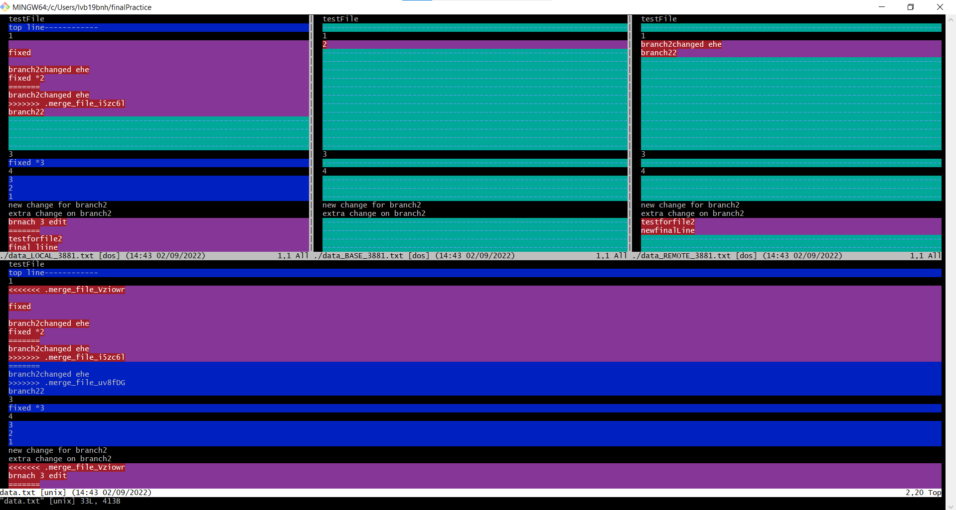
Command Line: Conflicts
The command line will not let you checkout any new branch if you try due to the conflicting changes
git toolmerge will then take you to a very simple Graphical User Interface (GUI) to then go through changes

Slide 43
Command Line: Conflict Resolution
In the merge tool editor, use the following commands to make changes:
i - insert text into a branch change
w - alternate window
:wqa - quit window
The bottom, larger window on the screen is the final version which will appear once saved
Edit this version when your happy, and type :wqa to save and quit the terminal
You should then be able to add, commit and push to the relevant GitHub branch
You should now to able to then checkout different branches and develop new lines of interest

Slide 44

Visual Studio (VS) Code and Git
To use Visual Studio Code, you must have these installed:
Git - https://git-scm.com/downloads
Visual Studio Code - https://code.visualstudio.com/
Optional package to work with GitHub :
GitHub Pull Requests and Issues extension
https://code.visualstudio.com/docs/editor/GitHub
Once you have a repository in GitHub (creating a new one through GitHub’s web interface is the easiest way, if necessary) you can check it out in Visual Studio Code and perform the full Version Control cycle therein.
Tutorial: https://code.visualstudio.com/docs/editor/GitHub

Slide 45
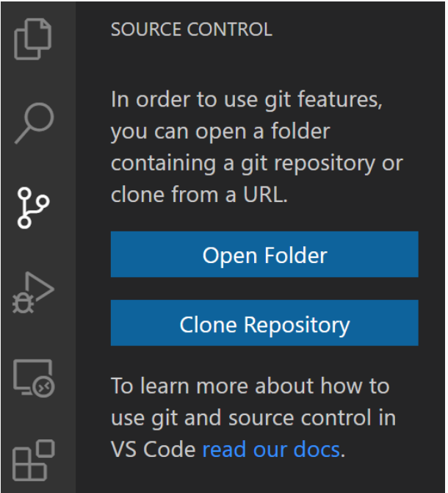
VS Code: Creating a Local Repository
It is not possible to create a local Git repository in VS Code interface, but you can clone one that exists elsewhere or open one that is on a local file system.
To create a local git repository, open VS Code and press CTRL + ' on Linux, macOS or Windows and type the following:
mkdir hello_world
cd hello_world
git init
This local repository can then be opened in VS Code via the Open Folder option under the Source Control tab.

Slide 46
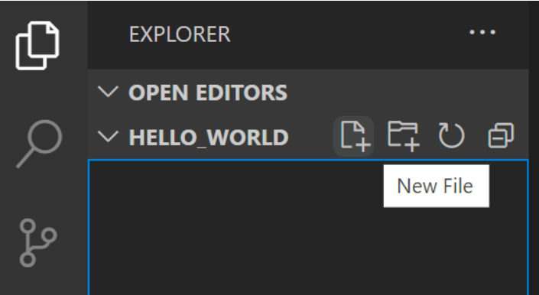
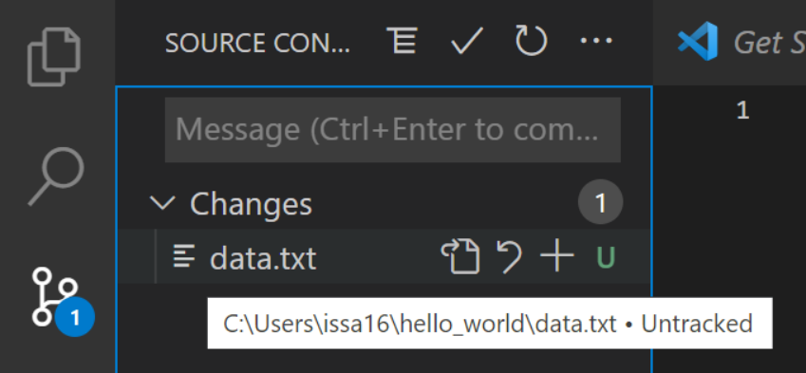
VS Code: Tracking Changes
Inside the hello_world directory create a file called data.txt
After doing so, you will see in the Source Control tab that the data.txt file shows up with the letter U besides it. U stands for untracked file, meaning a file that is new or changed, but has not yet been added to the repository.

Slide 47
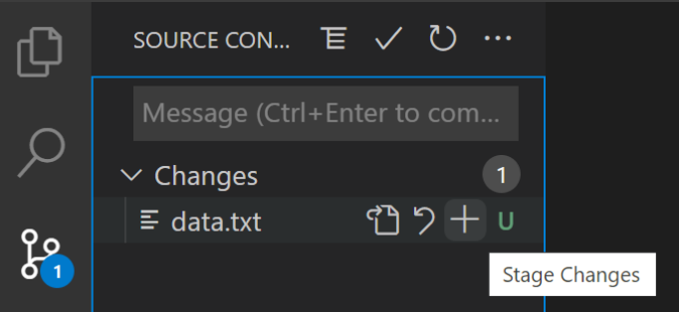
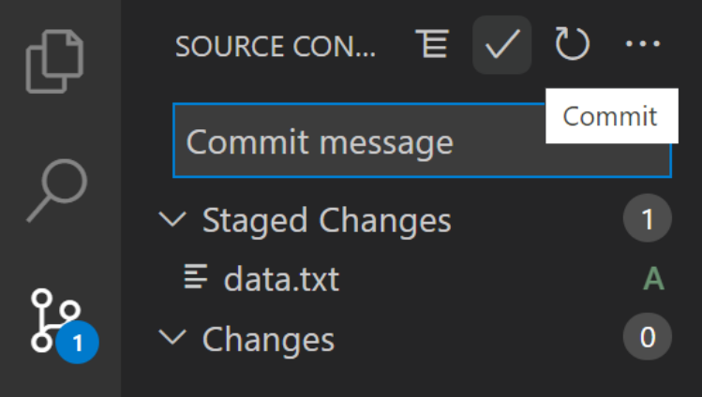
VS Code: Tracking Changes
Click the plus icon (+) by the data.txt file listing to track the file by the repository.
Once added, the letter next to the file will change to A. A represents a new file that has been added to the repository. To commit the changes, type a commit message into the input box at the top of the Source Control tab and click the check icon to perform the commit
You will notice that there are now no pending changes

Slide 48
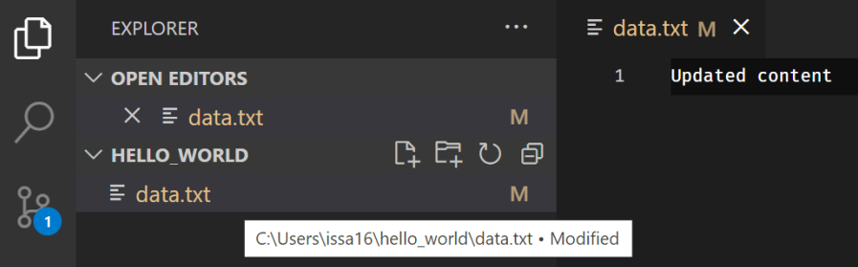
VS Code: Tracking Changes
Modify the contents of data.txt and save the file
In the Source Control tab you will see that the file has been changed. It will show the letter M next to it, which stands for a file that has been modified.
Click the plus icon (+) by the data.txt file to add the file to the staging area
To commit the changes, type a commit message into the input box at the top of the Source Control tab and click the check icon to perform the commit

Slide 49
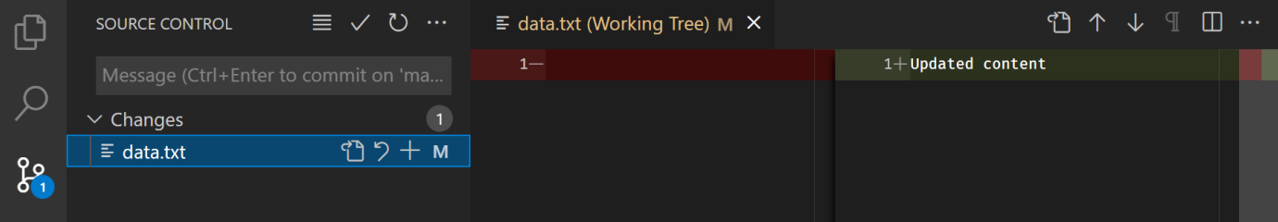
VS Code: Viewing Changes
To view the changes, open the Source Control tab and double-click the data.txt file. This will open a typical diff view with the previously committed version of the file on the left and the current version of the file on the right.

Slide 50
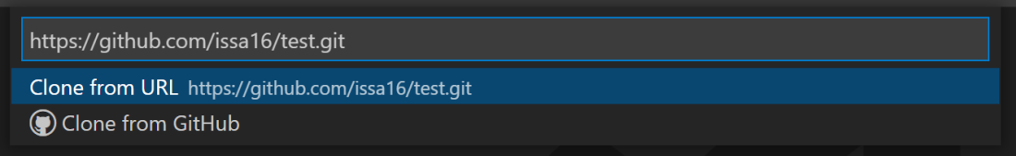
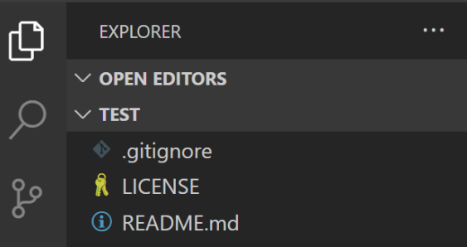
VS Code: Cloning from GitHub
Paste in the repository URL and press Enter.
A window should open to select a location where the local clone will go. VS Code will then download the repository from GitHub and offer the option to open the files.

Slide 51
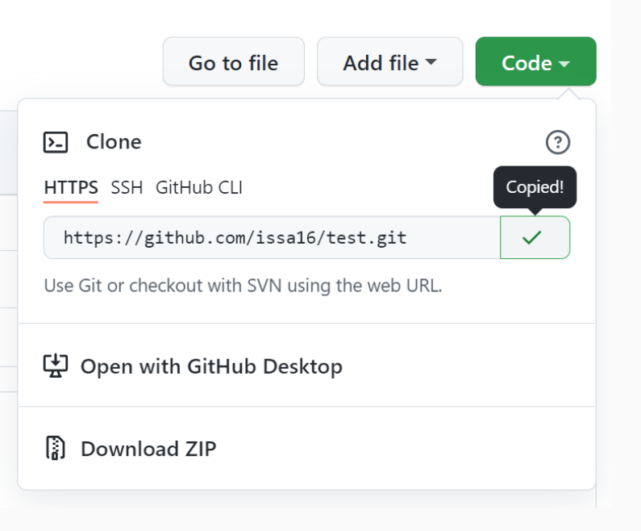
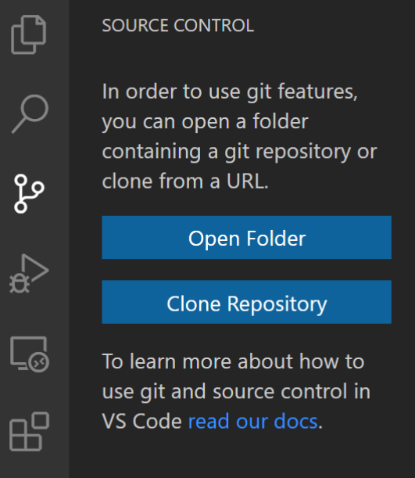
VS Code: Cloning from GitHub
Obtain the GitHub repository URL by clicking the code button on the repository homepage
This remote repository can then be cloned in VS Code via the Clone Repository option under the Source Control tab.

Slide 52
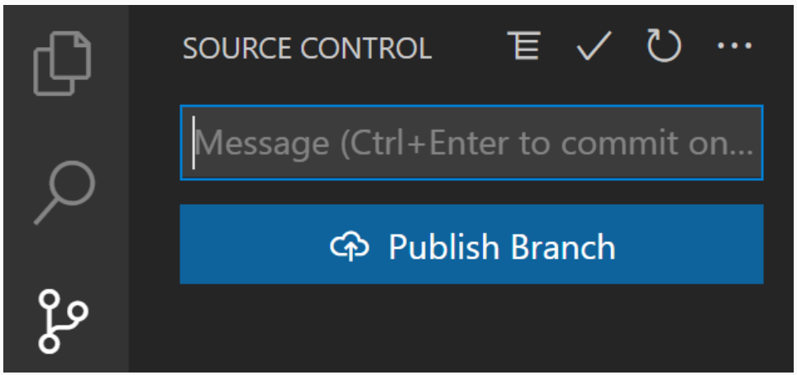
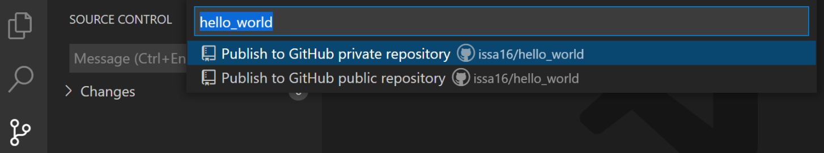
VS Code: Publish Branch
To upload our local git repository to GitHub, select the Publish Branch option that will be available after the initial commit in the Source Control tab:
Follow the prompt, you will be given the choice between a private and public repository

Slide 53
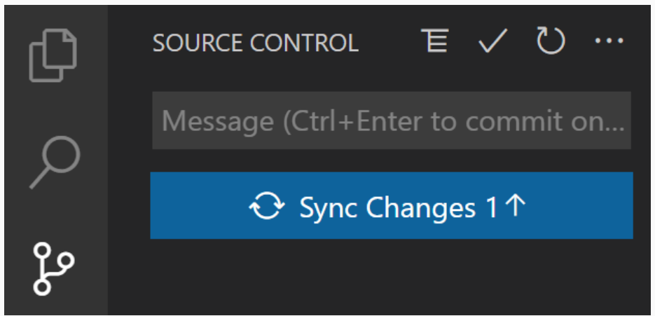
VS Code: Sync Changes (Push and Pull)
To upload our local commits to our GitHub repository, and to download any commits from GitHub to our local git repository, select the Sync Changes option that will be available after each commit in the Source Control tab.

Slide 54
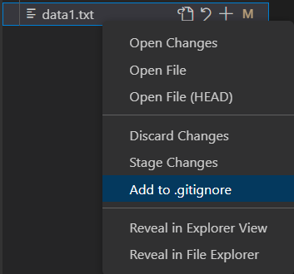
VS Code: Ignoring Files
If we wish to ignore the changes to a file and not sync them using version control, we can make use of gitignore
Right-clicking on the file in VS code and selecting .gitignore will send the changes to a .gitignore file which will remain untracked

Slide 55
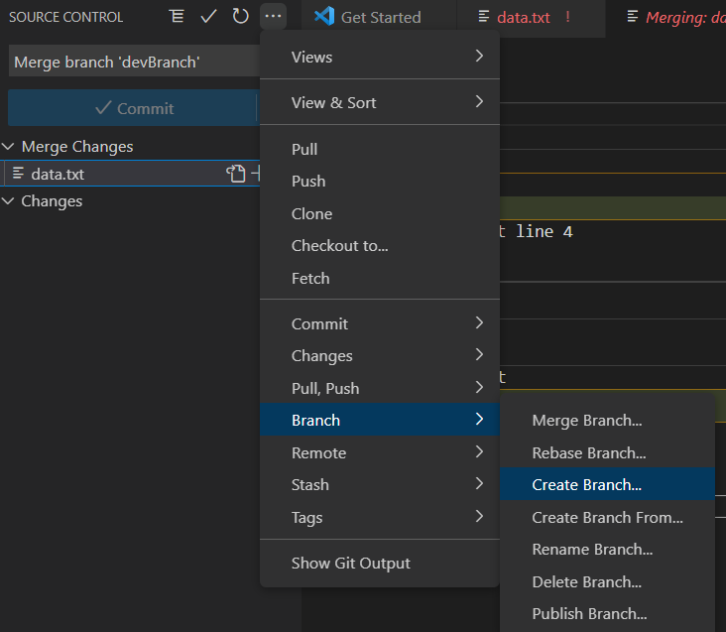
VS Code: Creating Extra Branches
As mentioned, branches are often used for separate lines of development or by sperate team members working on the same project
In VS code, when you begin using version control, it defaults to working on the main branch
We can check this out by typing git branch into the terminal and the *main will show representing the main branch of development
We can create a new branch using the … in the version control tab and then choose the branch name:

Slide 56
VS Code: Creating Extra Branches
We can then work on a new lines of development on the new branches and check which branch we are on with the git branch command in the command line:
PS C:\Users\lvb19bnh\finalPrac> git branch
devBranch
devBranch2
* Main
We can move from branch to branch with the command git checkout <branch name>
Good practice to execute the git branch command again after checking out a new branch to double check you are working on the correct branch
The practice of adding to the staging area, committing with a message and pushing to the remote repository (GitHub) is the same for any new branches

Slide 57
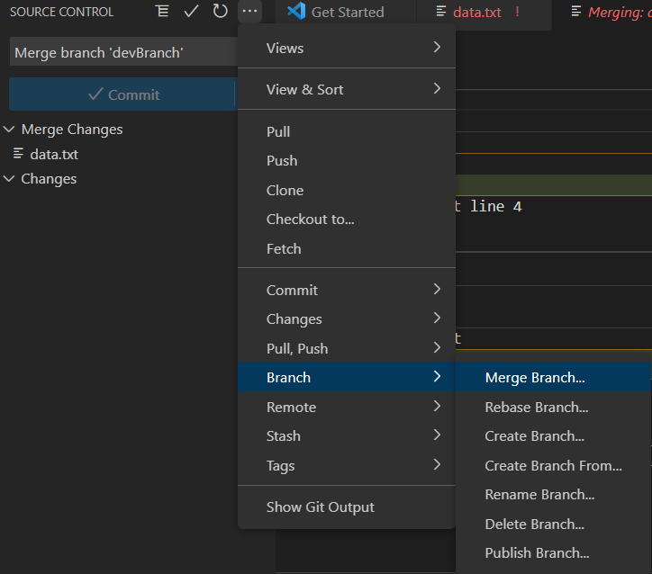
VS Code: Conflicts
At some point a more updated, or final version of a project is needed meaning that the changes from the different lines of development or branches need to be brought, or merged together
Firstly, ensure you are in the correct branch by using the git branch in the terminal and using git checkout to move to the correct one if you need to move
You can then merge developments from another branch into the branch you are in by either using the merge option in the version control window tool bar (shown right)
Or by typing into the terminal:
git merge <banchName1> <branchName2>

Slide 58
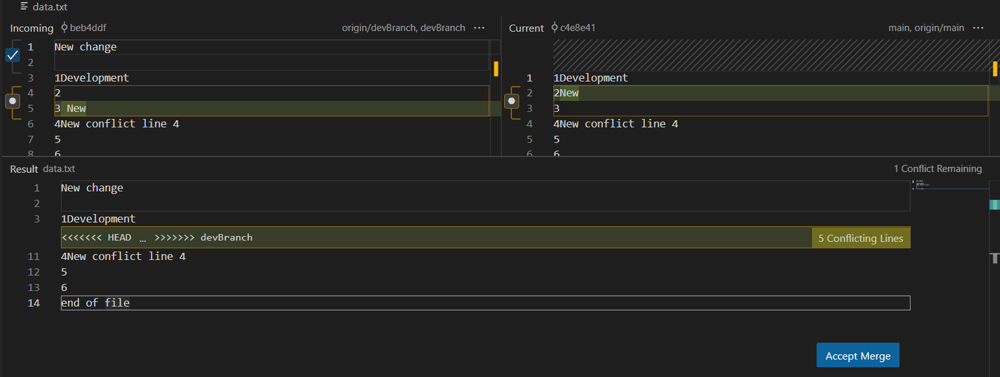
VS Code: Conflicts
If you are working individually, and are working with only 2 branches, the main staying the same and then updating this main with changes from a single development branch, no conflicts will arise due only 1 branch having updated changes to it at any one time
However, if there are changes to more than 1 branch on the same lines, it is likely conflicts will arise
This is due to the program not knowing which change from each different branch to stick to
To assist you in working through conflicts, VS code will give you the option of taking you to the merge editor:

Slide 59
VS Code: Conflicts
You can select which branch you wish to keep by ticking the icon to the left of the line with the conflicting changes
Then clicking accept merge will update the branch with the new changes
Remember, you will still need to add to staging area, commit and push this updated branch

Slide 60

RStudio and Git
Version control doesn't have to be at the command-line. As mentioned, it integrates nicely with graphical development Environments as well.
To use with RStudio, you must have these installed:
R - https://cran.r-project.org
RStudio - https://rstudio.com/products/rstudio/download/
Git - https://git-scm.com/downloads
Once you have a repository in GitHub (creating a new one through GitHub's web interface is the easiest way, if necessary) you can check it out in RStudio and perform the full Version Control cycle therein.

Slide 61
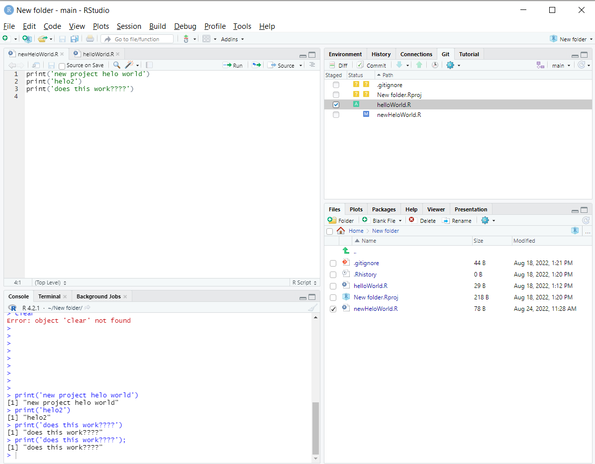
RStudio and Git
When you make a new RStudio project and make the initial save, the “GIT” icon will normally appear in the top right quarter menu on the screen:

Slide 62
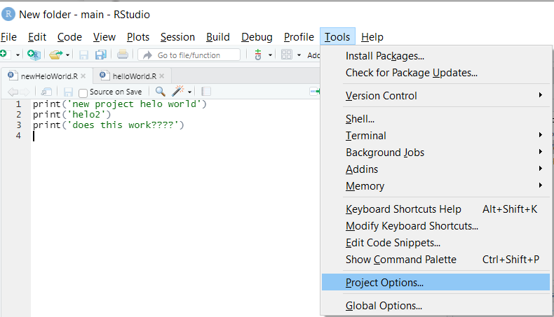
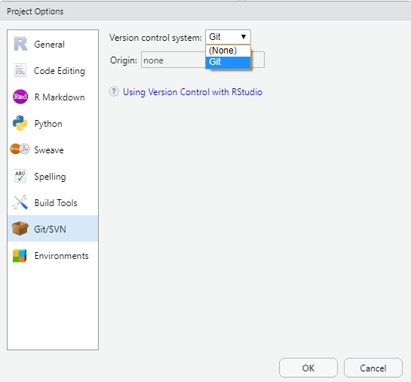
RStudio and Git
If the Git icon does not appear in this location, go to:
Tools -> Project Options… -> Git/SVN -> Origin -> Git
The Git option should now appear in the area described on the previous slide

Slide 63
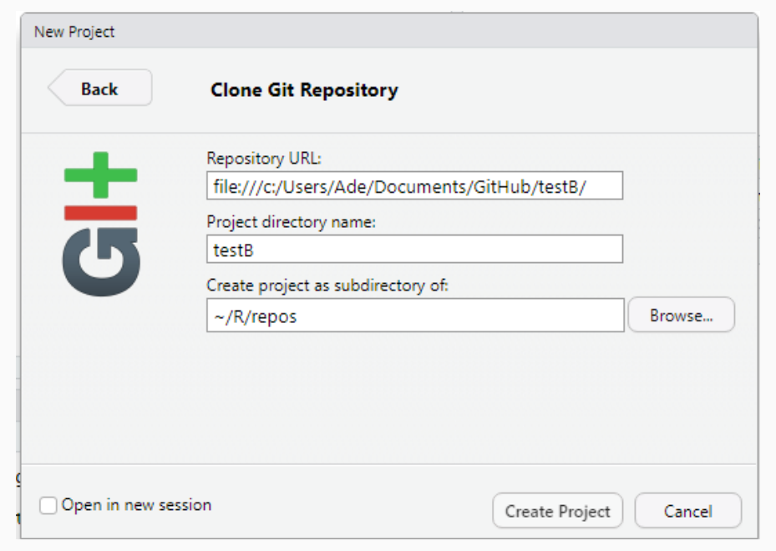
RStudio – Creating a Local Repository
It is not possible to create a local Git repository in RStudio's interface, but only to clone one that exists elsewhere - be it on a local file system or on GitHub.
To create a local one, use the command line and run git init. In Windows, open Command Prompt and run something like this:
mkdir hello_world
cd hello_world
git init
This local repository can then be cloned in RStudio via a local URL style like this:

Slide 64
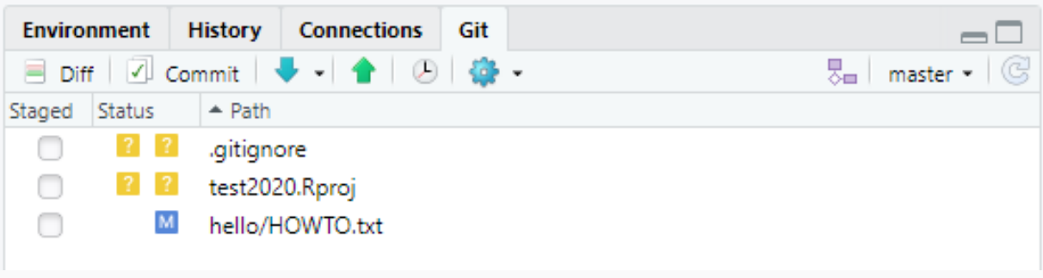
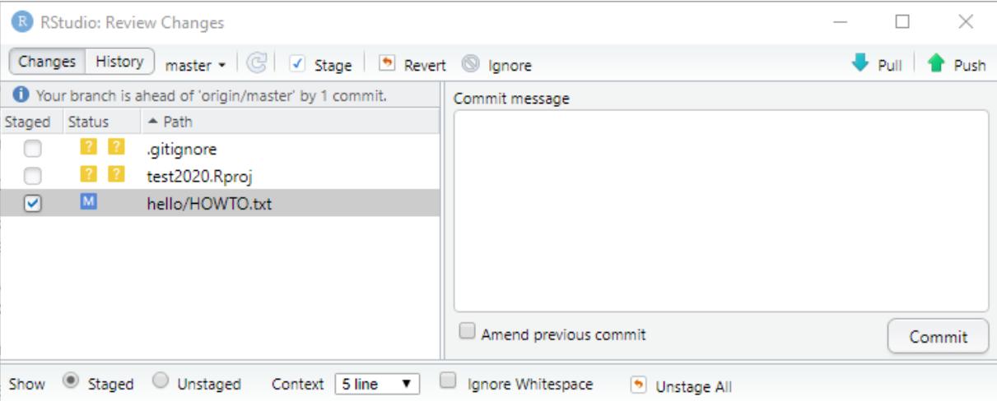
RStudio: Tracking Changes
Modify a file from the working copy via the RStudio File Browser (bottom-right quadrant), once saved notice the 'Git' tab sees this file as modified:
Now to commit this, we need to tick the box next to the file and press the commit button, after which we are presented with the Review Changes windows in which we see the commit being staged and also enter our Commit message:
RStudio will then show the output of the Git commit. We now see the message that "Your branch is ahead of 'origin/master' by 1 commit" showing that we have not pushed this change from the stage to the main repository origin.

Slide 65
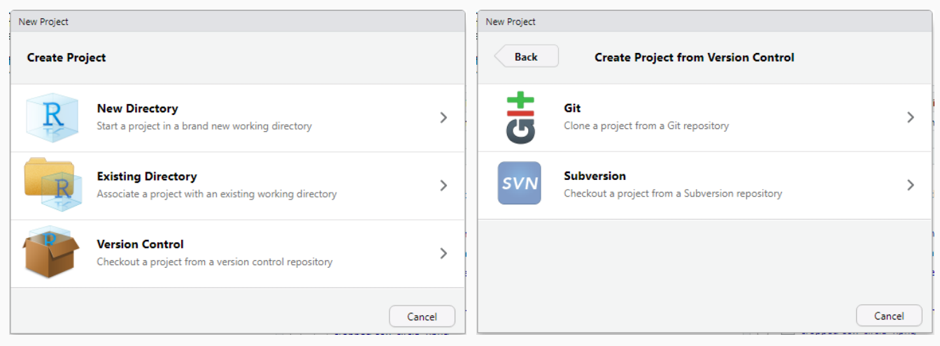
RStudio: Cloning from GitHub
To clone in RStudio from GitHub, we simply use a URL that points to the GitHub repo rather than a local repository.
In RStudio start a new project:
File -> New Project -> Version Control -> Git
If Version Control not available try restarting RStudio and/or reinstalling the required components as your system paths are most likely incorrect*

Slide 66
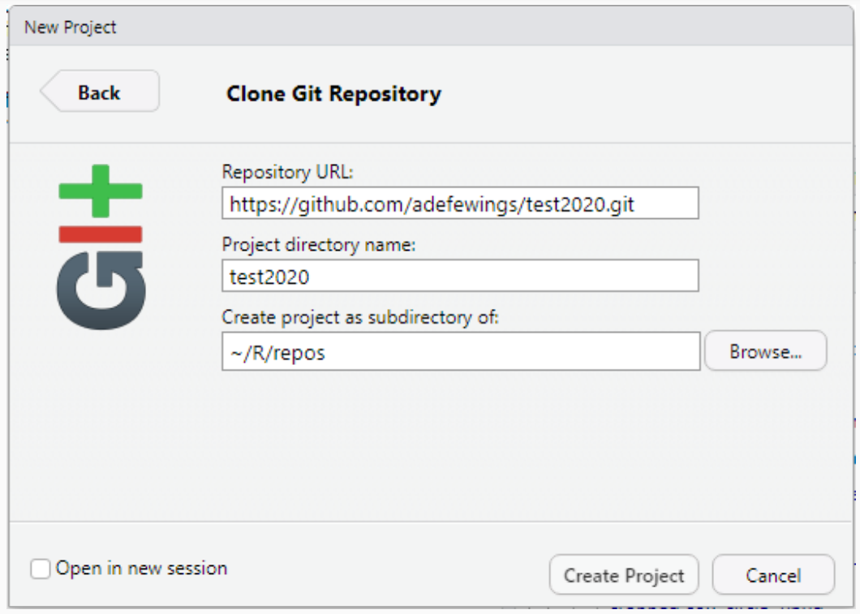
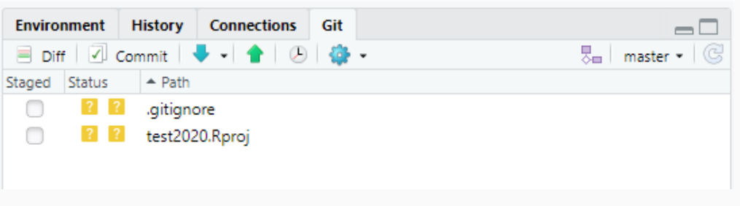
RStudio: Cloning from GitHub
Put the URL to the GitHub repository in (from the GitHub web interfacece under Clone or download) and consider where the clone will go
Click Create Project
RStudio will clone the repository into a working copy and open therein
Notice that the new window opened has a Git option in the top-right pane:
Buttons here represent the principal Git functions:

Slide 67
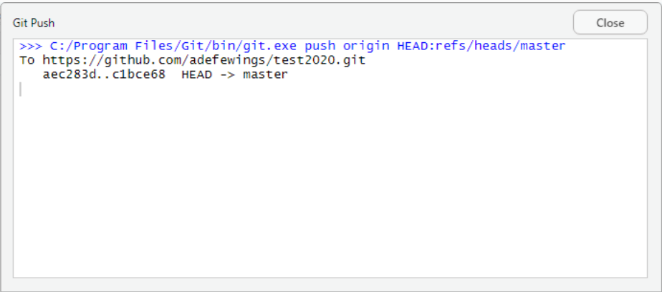
RStudio: Push to GitHub
Once we have staged changes and are ready to commit to the origin, this can be achieved either through the 'Review Changes' window or the main Git tab in the RStudio project editing window.
Simply select the green up arrow, provide your GitHub credentials if prompted and see a push result:
Our changes have now been pushed up to the repository on GitHub

Slide 68
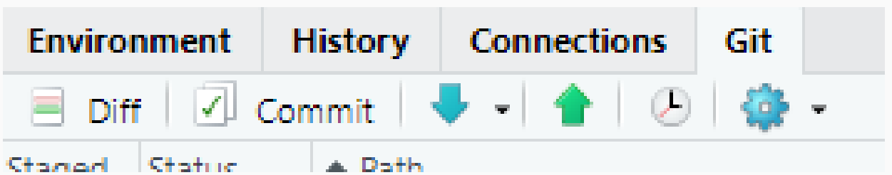
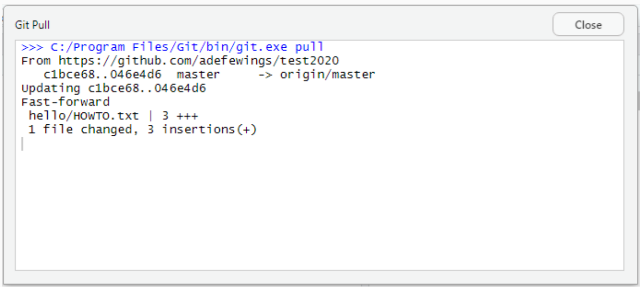
RStudio: Pull Changes from GitHub
It's trivially easy to pull any changes from the GitHub repository for a working copy (clone) by pressing the blue down button:
Which will result in display of the Git activity:

Slide 69
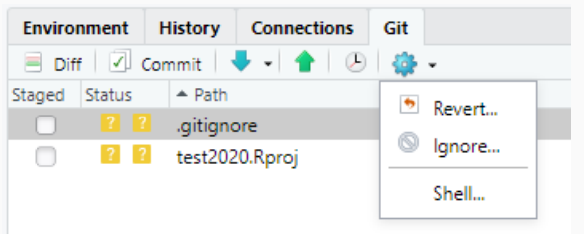
RStudio: Ignoring Files
Similarly, to ignore files in RStudio, under the 'Git' tab, we can click the Blue Settings Cog icon and choose ignore to adjust the list of ignored files (as itself stored in .gitignore):

Slide 70
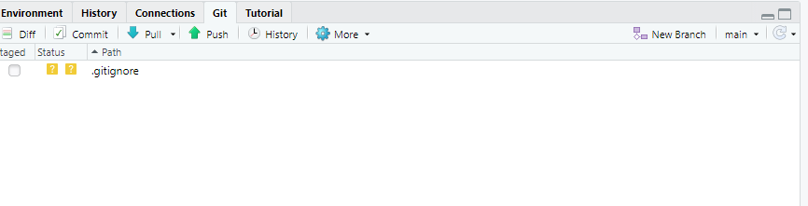
RStudio: New Files
When wanting to start a new line of development individually or for a team member, often a new branch is used to accommodate this
Either click on “new branch” in the top right window:
or in the terminal, type git branch <newBranchName> and then git checkout <newBranchName>
You can then make new changes on the new branch

Slide 71
RStudio: Merging and Conflicts
At some point in script development, we will need to merge different branches
There is no simple merge command on the GUI of RStudio but we can easily merge branches in the RStudio terminal
Type: git merge <branchName1> <branchName2>
If there are only changes on one branch, such as a single development branch then merging branches should happen automatically
When there are changes to multiple branches on the same lines, conflicts will appear and will be visible in the script editor
When you have resolved the changes simply commit like you would have normally and push to the remote repository

Slide 72
Licensing
When code or other creative work becomes public, it should include a LICENSE or LICENSE.txt in the base directory of the repository
It should clearly state under which license the content is being made available
Reusing creative works without a license is dangerous because the copyright holders could sue you for copyright infringement
Choose an open source license
People who incorporate General Public License (GPL’d) software into their own software must make their software also open under the GPL license; most other open licenses do not require this
The Creative Commons family of licenses allow people to mix and match requirements and restrictions on attribution, creation of derivative works, further sharing, and commercialisation
People who are not lawyers should not try to write licenses from scratch

Slide 73
Citation
Basic
You may want to include a file called CITATION or CITATION.txt that describes how to reference your project
More detailed advice and other ways to make your code citable can be found at the Software Sustainability Institute
Example
Advanced:

Slide 74

Citation: DOI Referencing
In research, papers are often cited with specific identifiers known as Digital Object Identifiers (DOI’s)
These make it easy to find a specific paper in an online journal as there is a unique identifier
Can easily give the original publishers credit
We can then simply copy and paste this DOI into our browser to show us the original article

Slide 75

Citation: DOI Referencing
Just like we should reference and cite a body of text in a research paper/article, we should also cite code used from a GitHub repository using it’s DOI
This means that if we’ve created and developed a repository, then we should assign it a DOI to allow others to easily find it and cite it where necessary
To do we make use of 2 websites:
Your GitHub repository account
Zenodo
Zenodo is a company that you cab grant access to your GitHub repositories and will assign a unique doi to specific repo’s

Slide 76
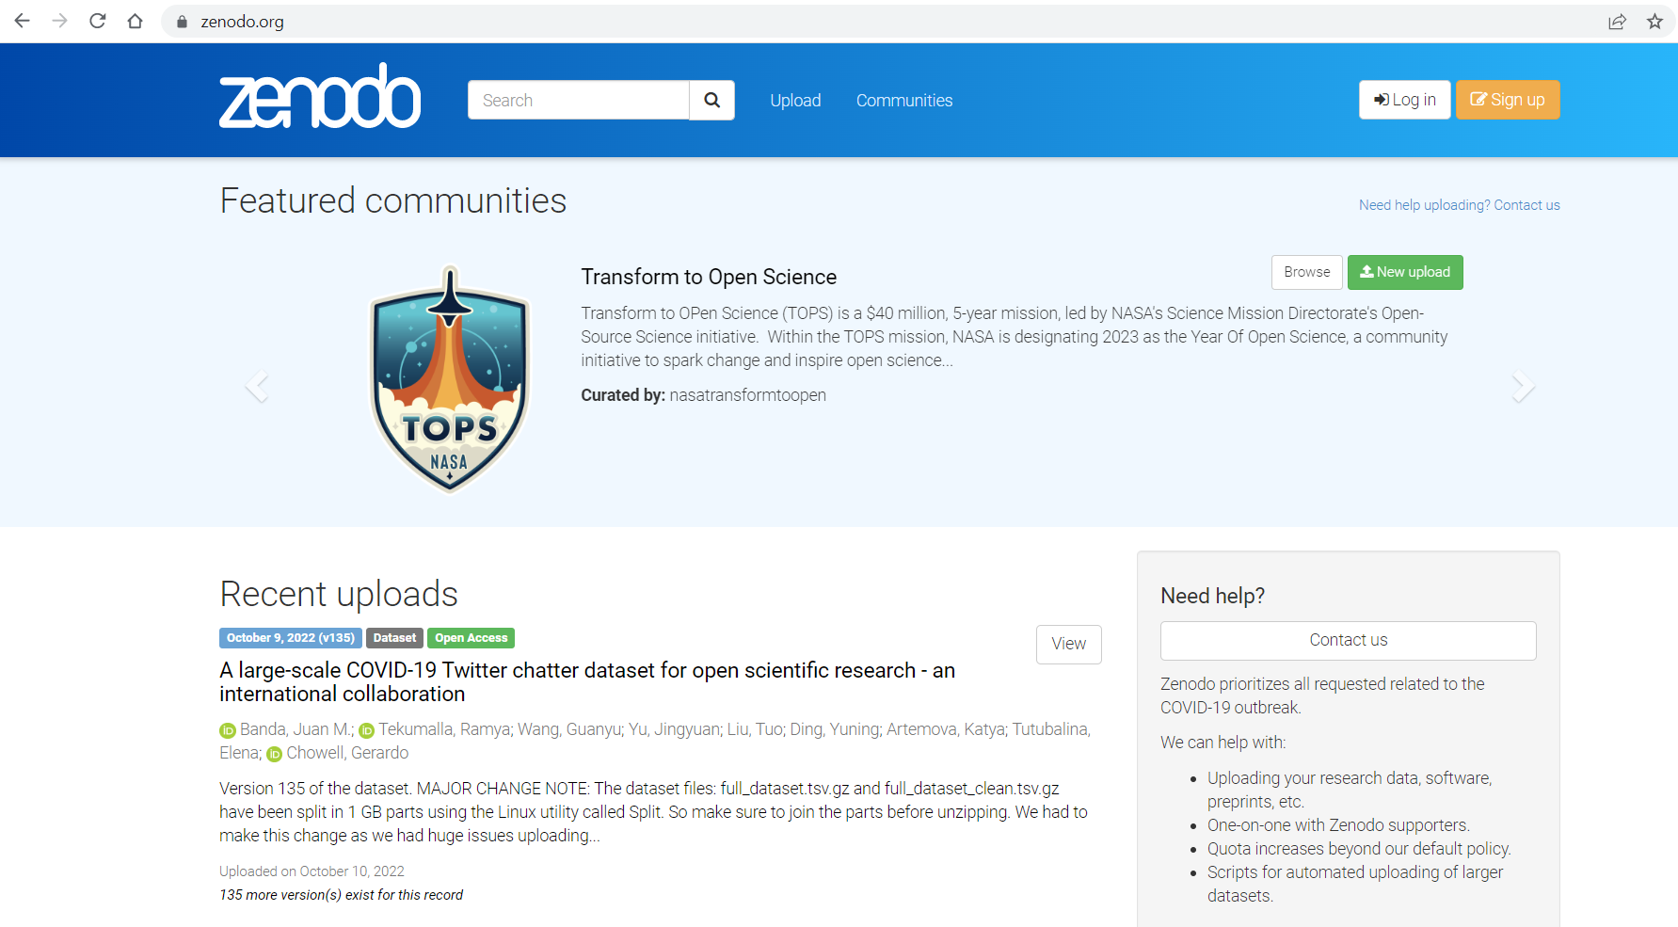
Citation: DOI Referencing
To utilise Zenodo’s resources, either follow the link on the previous slide or use this one
We then need to sign in
You don’t need to create an account as you can sign in with your GitHub credentials, so select ‘Log in’ located on the top right of the home screen

Slide 77
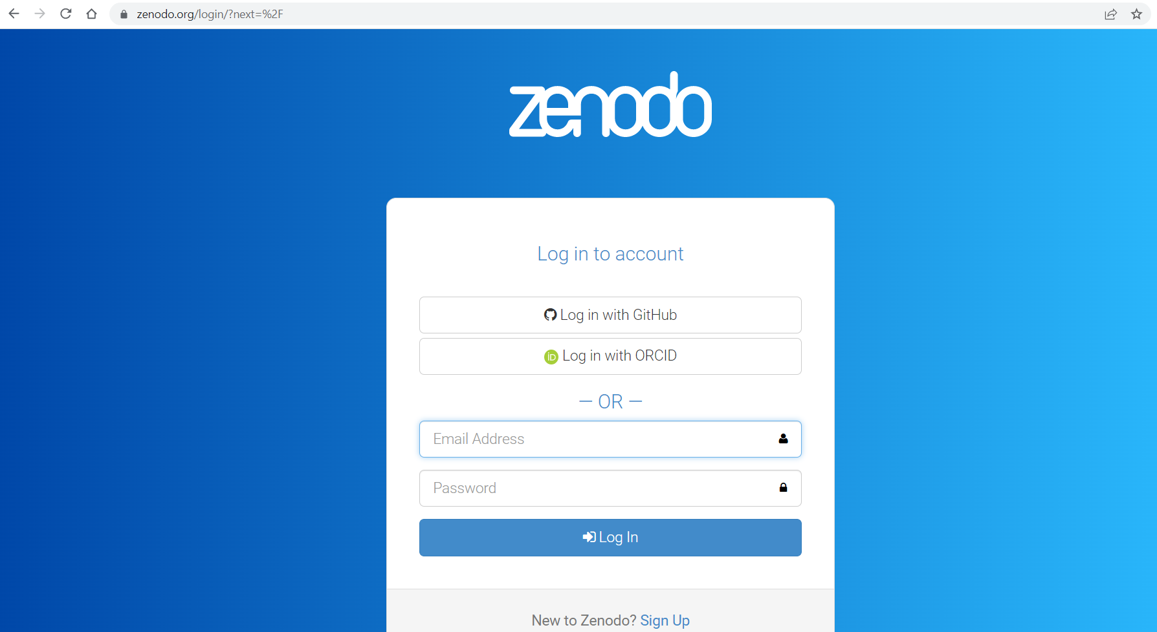
Citation: DOI Referencing
Either use the following link or the previous slides instructions
Select ‘Log in with GitHub’
And enter your GitHub login credentials

Slide 78
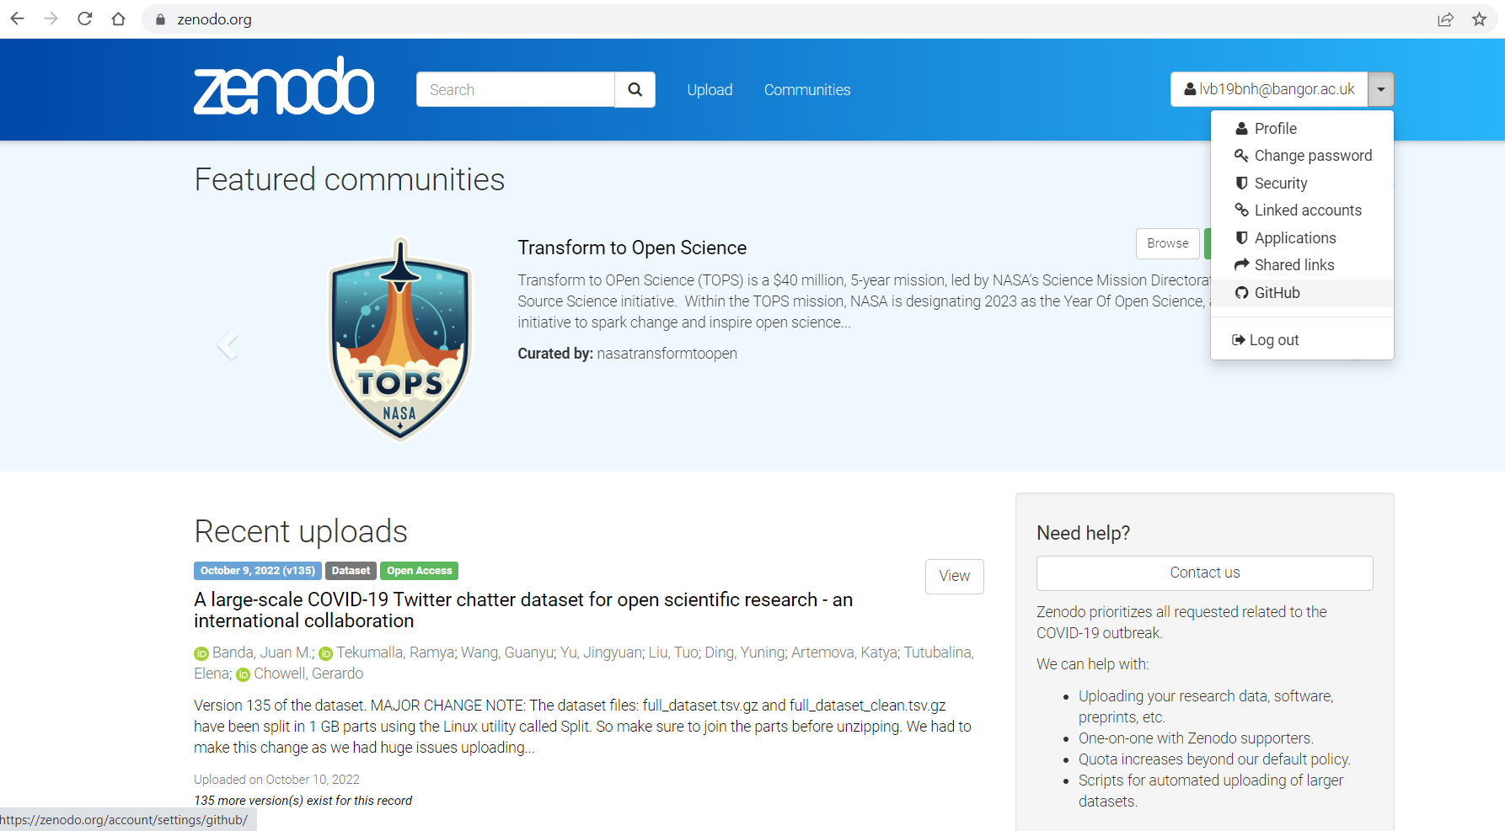
Citation: DOI Referencing
On the home screen next to your username where the Log in icon was, select the drop down menu and select GitHub from the options:

Slide 79
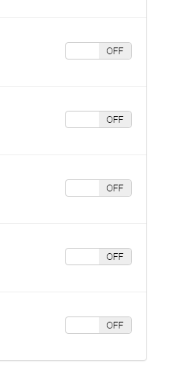
Citation: DOI Referencing
You should now see all of the repositories tied to your GitHub account
All of the switches on the right of the specific repository panel should initially be on ‘off’
To toggle the switch to on, simply click the switch

Slide 80
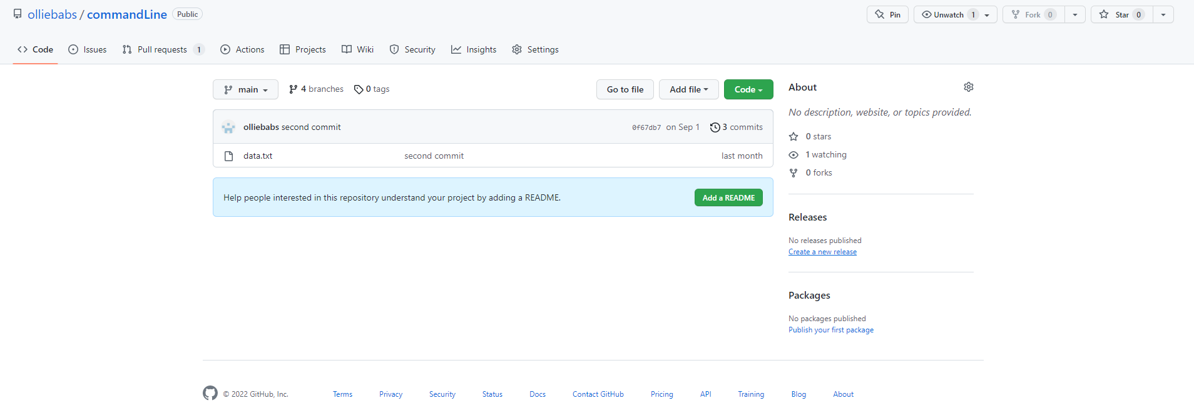
Citation: DOI Referencing
Of the repository which you want to have an associated DOI, toggle the switch to on
When you make a new release to the repository in GitHub a DOI will automatically be generated
If you don’t know how to make a release, go to the specific repository in GitHub and select ‘create a new release’

Slide 81
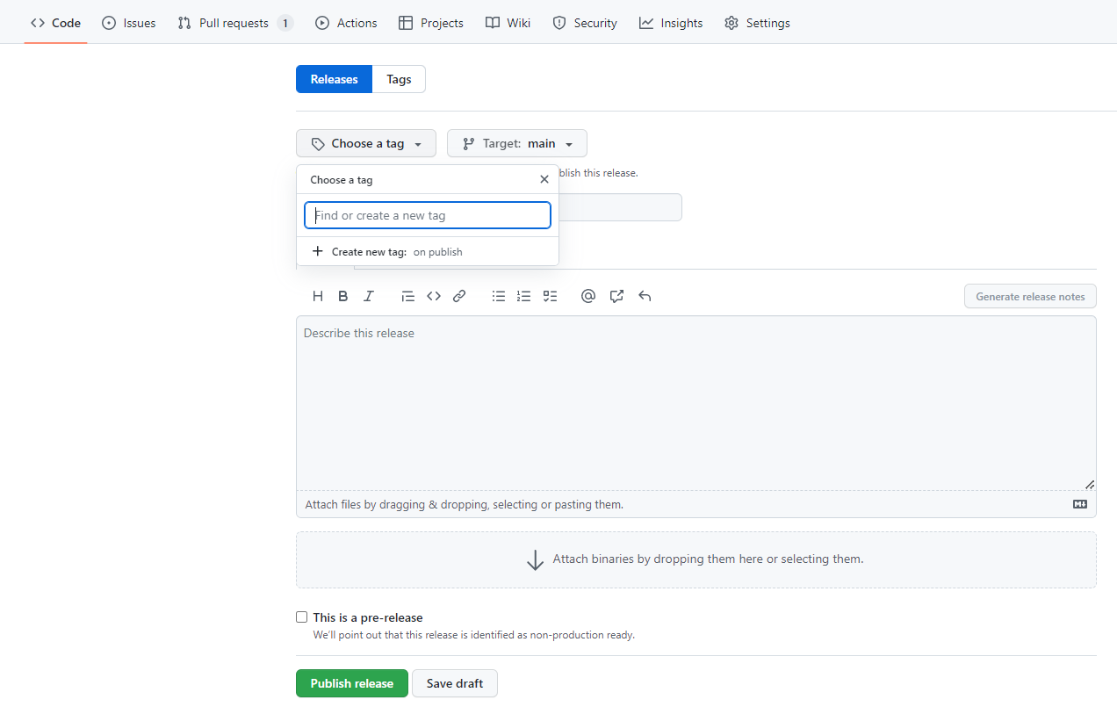
Citation: DOI Referencing
Choose a specific tag if there is one to chose from or create a new one from the option (e.g. v1/ v1.1) and select the specific branch
Add a title and description and select ‘Publish release’ on the bottom left of the screen when you are ready

Slide 82

Citation: DOI Referencing
If you then go back to Zenodo, you should see the DOI which has been created next to the repository label
Clicking on the repository should display some more useful information with regards to the DOI

